Slide 1


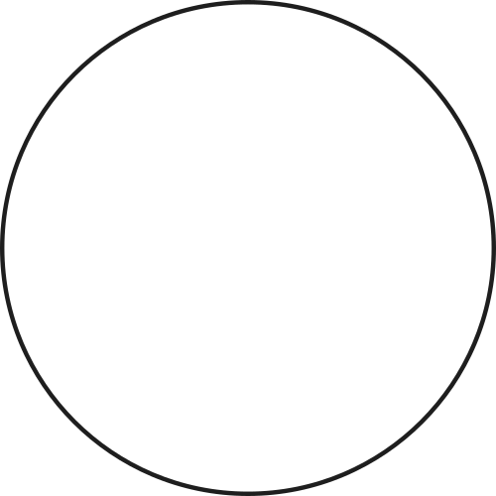
Sales Strategy Analysis for New Office Stationery
Optimizing Sales Methods for Pens and Printers
Presenter: Travis Hopkins
May 30, 2024

Slide 2


Introduction
Company Name
Pens and Printers
The Latest Office Stationery Sales Launch
New Product
Office stationary
Goal
Determine the most effective sales method for the latest and future launches.

Slide 3


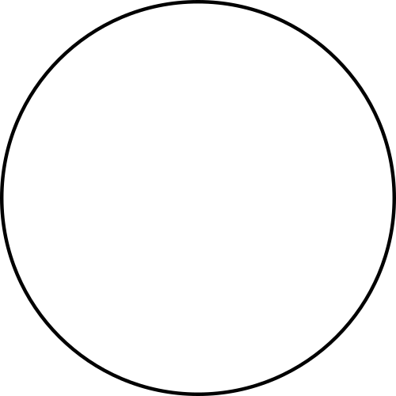
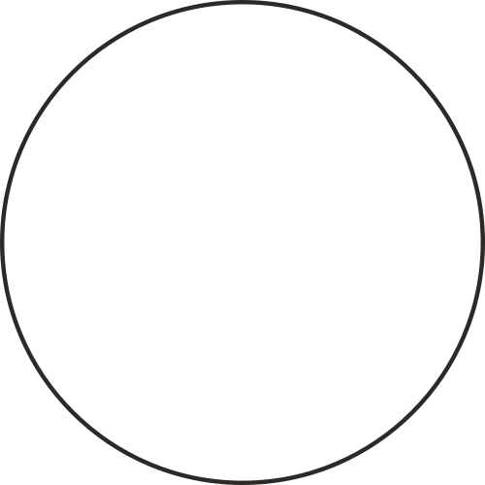

Sales Strategies
Email: Minimal effort, two emails sent.
Phone Call: Personal calls, 30 minutes each.
Email + Call: Initial email, follow-up call, 10 minutes each.
Our sales strategy focuses on targeting which method has the highest sales efficiency and a moderate workload and utilizing business metrics for increased reach and sales growth.

Slide 4


Dataset contains 15,000 rows, 8 columns.
Identified missing values and appropriately filled them in based on the spread of the data.
Data Validation
Cleaned for typos, mixed cases, and confirmed data types.
Data validation ensures that data follows rules and stays accurate, preventing mistakes and keeping it reliable.
Potential outliers were identified in units sold and revenue.

Slide 5
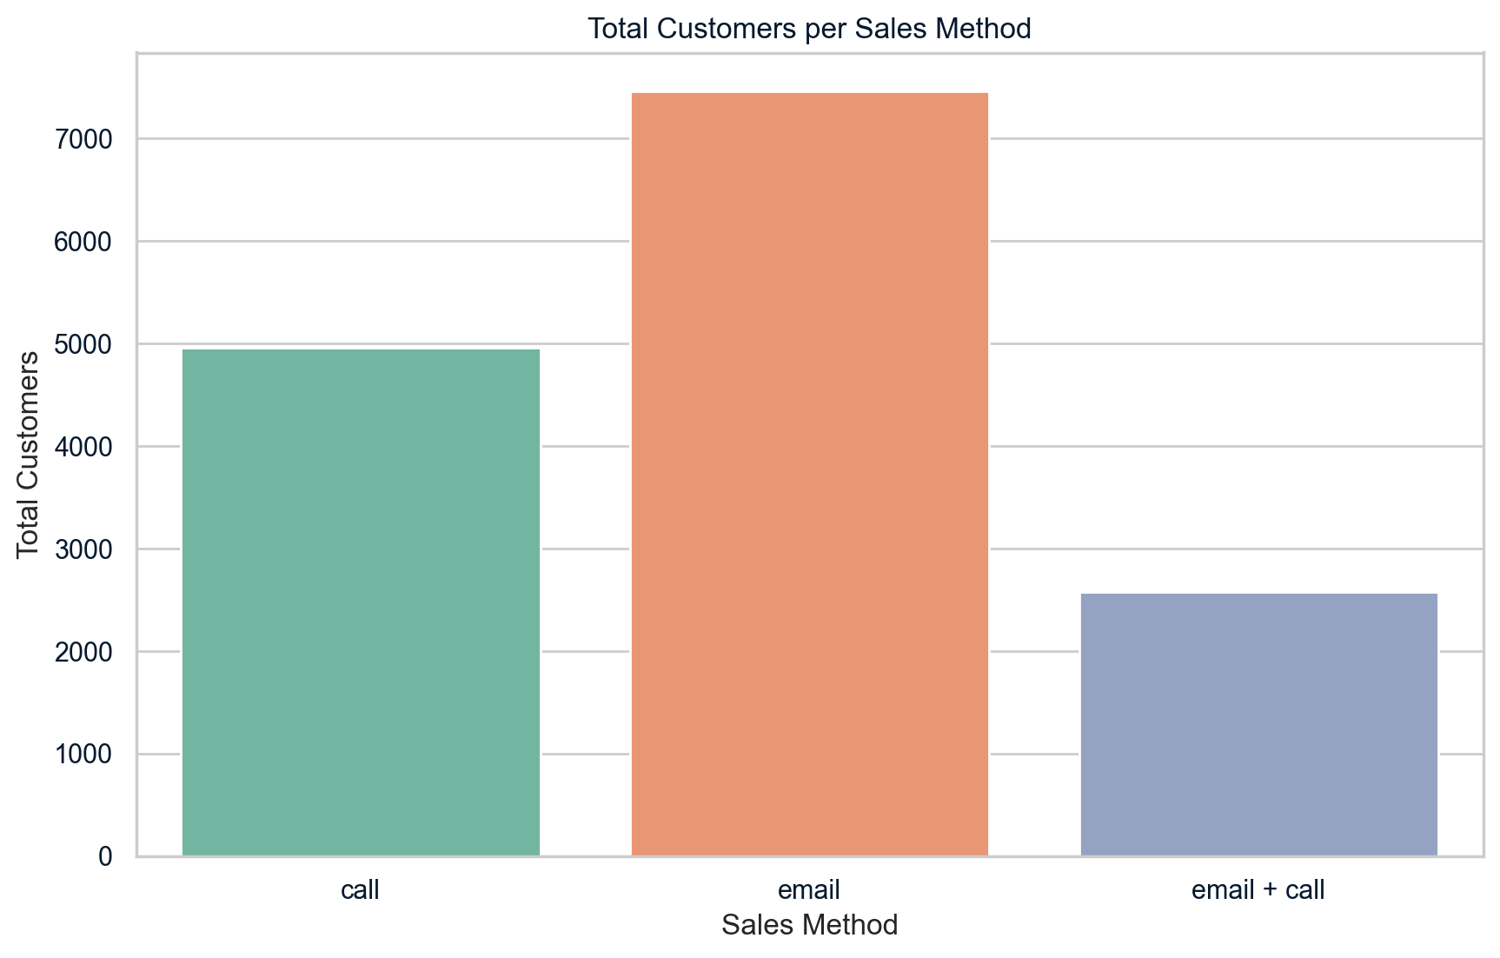
Customer Count by Sales Method
The graph shows the number of customers for the three sales methods.
Email brought in the most customers with over 7000.
The combination of email and calls brought in the fewest customers, with around 3000.

Slide 6
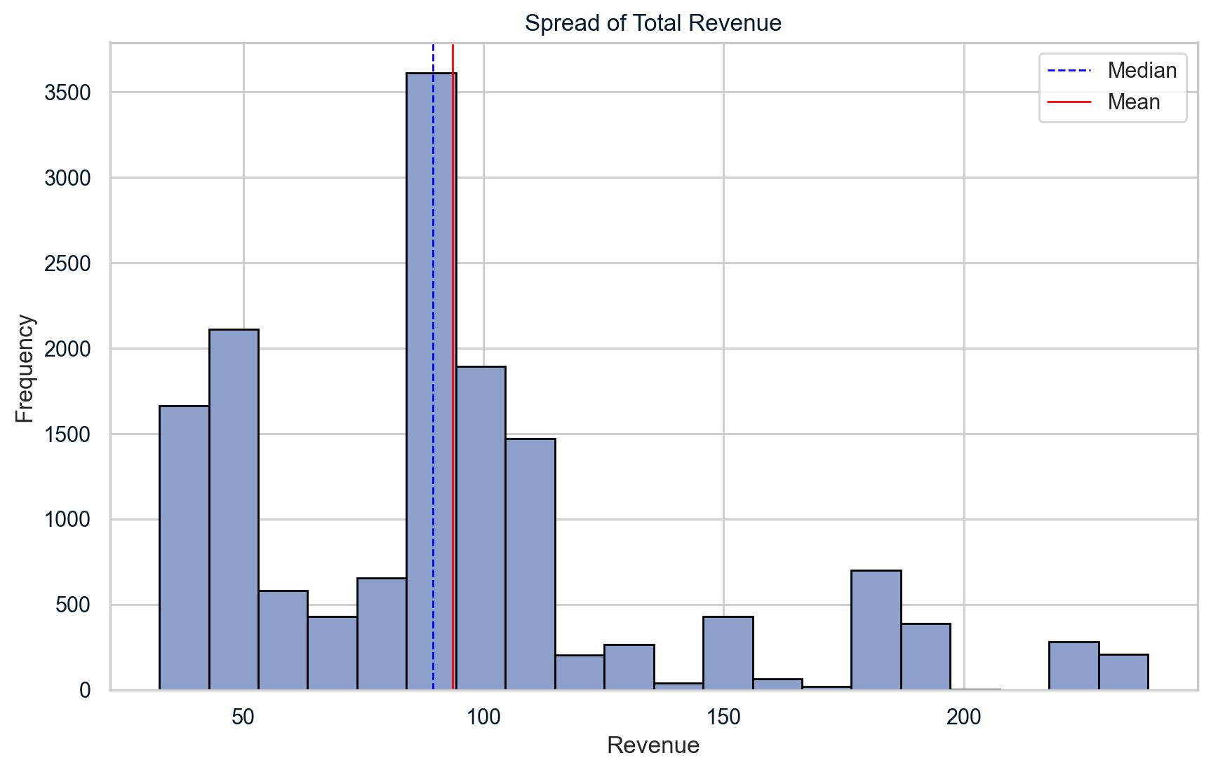
Revenue Distribution
Most sales are around $90.
Right-skewed distribution with some high-revenue outliers.

Slide 7
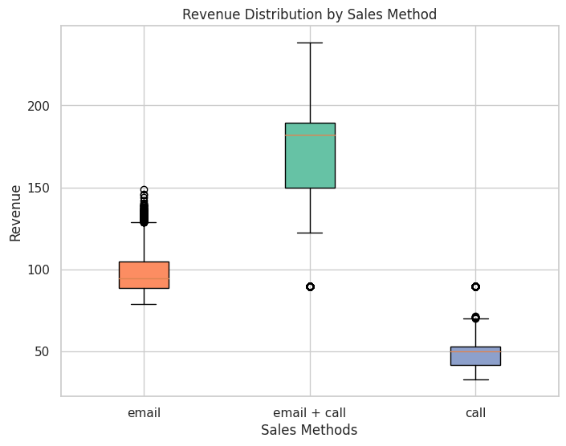
Spread of Revenue per Sales Method
The box plot shows how much money each sales method makes.
Email + Call makes the most money on average but has the most ups and downs.
Both email and call methods separately make less revenue on average and are more steady, with fewer unusual amounts.

Slide 8
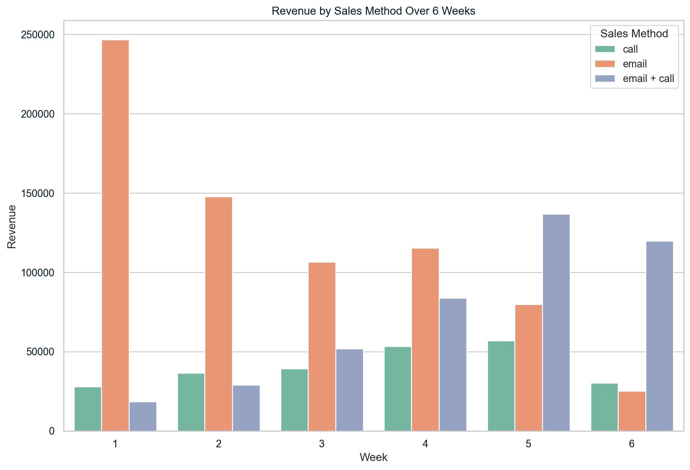
Revenue Over Time
The graph shows the revenue generated by three different sales methods over six weeks.
Email strong initially.
Email + Call method has gained effectiveness.
While the email method started off the strongest, combining email and calls became more effective over time, especially in the last two weeks.

Slide 9
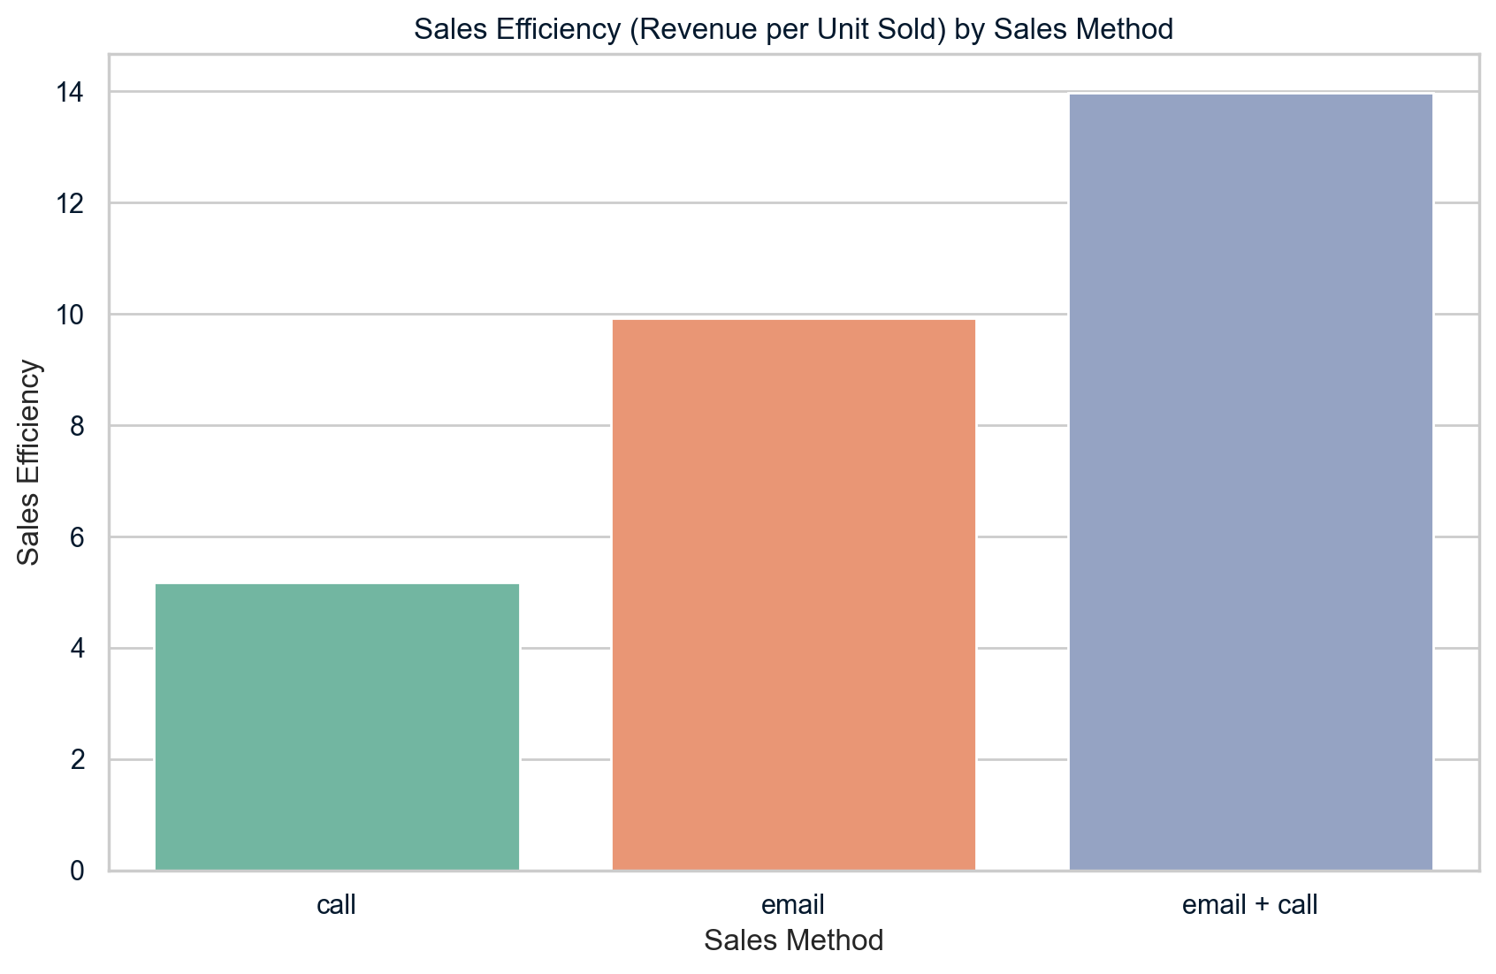
Sales Efficiency
The sales efficiency metric is calculated by total revenue divided by number of units sold.
Email + Call: $13.98 revenue per unit.
Email: $9.93 revenue per unit.
Call: $5.17 revenue per unit.
The graph shows Email + Calls exhibit the highest efficiency, with emails ranking second and calls trailing behind in last place.

Slide 10

Recommendations
Which Sales Method To Use
Future Data Collection
To determine the best sales method for the new product launch, we need to consider the sales efficiency, our business metric, and the workload involved.
To perform a more in-depth analysis we want to improve data collection
Collect more data for better analysis:
Improve data by determining the average time spent on email sales per customer.
Use this data to see which method has the highest revenue per time spent.
Gather more data on which method gets the most sales from new and repeat customers.
Based on the analysis, I suggest utilizing the Email + Call method. Despite initially bringing in fewer customers, this method generated the highest revenue per unit sold, indicating its effectiveness in maximizing sales efficiency.
Watch these methods and change plans based on how they are doing to make the best use of time and resources.

